Slide 1
VGA Control
using rotary encoder
Instructed by: Dr. Musa Alyaman
Slide-1

Slide 2
Table of Content
01
Introduction
02
Verilog modules
03
ASM chart
04
Conclusion
Slide-2

Slide 3
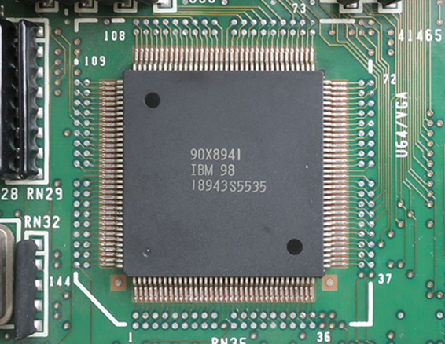
Introduction
Purpose of the project
To modify the VGA code by adding a rotary switch that controls what color is generated on the monitor.
The VGA
Video Graphic Array.
A standard interface introduced by IBM back in 1987.
It has 2 main display modes: character display and graphic display.
It also has 3 kinds of graphic display modes: compatible CGA and EGA, standard, and expanding.
The VGA transforms data through 2 types of signals: the VGA data signal (the tricolor signal), and the VGA control signal (horizontal and vertical synchronized signals).
Slide-3

Slide 4
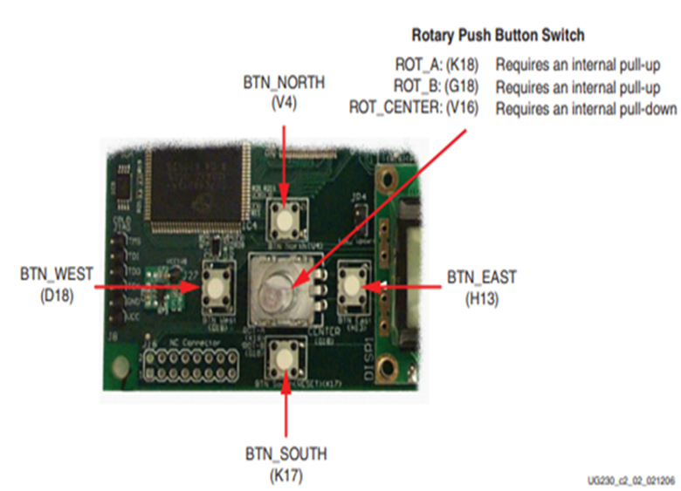
Introduction
The rotary switch
The rotary switch of the FPGA Spartan-3E kit is located in the center of 4 individual push-buttons
It is a shaft encoder with 3 outputs, ROT_A, ROT_B, ROT_CENTER.
In this project, the focus is rotating the switch to change the colors on the screen, using ROT_A, and ROT_B.
The rotary switch is prone to bouncing (chattering), chatter is an interrupt of an extra rotation (click) in either directions of rotation, this issue is solved through programming.
Slide-4

Slide 5
Verilog Modules
The main module, the rotary filter and direction, the color generator
Slide-5

Slide 6
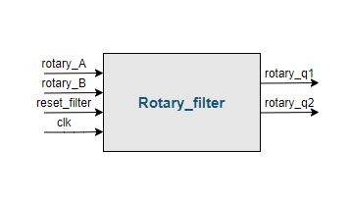
The Rotary Filter
The filter is used to solve the problem of chattering.
Rotary_A, and Rotary_B represent the two states of the rotary switch.
Rotary_q1 indicates the change from low to high, and Rotary_q2 represents the direction of rotation.
To eliminate this effect completely, only the first change of signal is detected.
When both Rotary_A and Rotary_B are 1, Rotary_q1 is 1, if they are 0, then Rotary_q1 is 0.
Slide-6

Slide 7
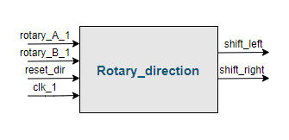
The Rotary Direction
Rotation to the right turns Rotary_A to high, and Rotary_q2 takes the value of 0, giving the shift_right register the value of 1.
Rotation to the left turns Rotary_B to high, as well as Rotary_q2, giving the shift_left register the value of 1.
shift_left and shift_right registers can be then used yto control the color generation.
Slide-7

Slide 8
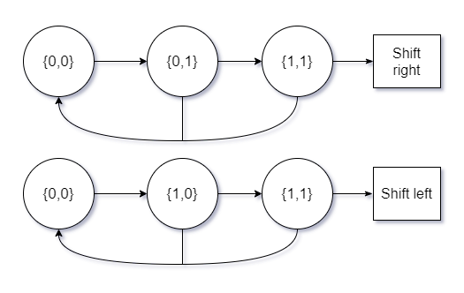
The Rotary Direction
For the registers to act it should go through the sequence shown in the figure.
This is a gray code sequence
Slide-8

Slide 9
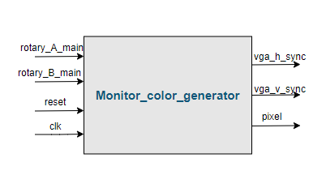
The Color Generator
To determine the output color, we first implemented 2 counters.
First counter to count how many times the switch was rotated to the right.
Second counter counts how many times it was rotated to the left.
These 2 counters are compared, and the output is used to generate colors.
Slide-9

Slide 10
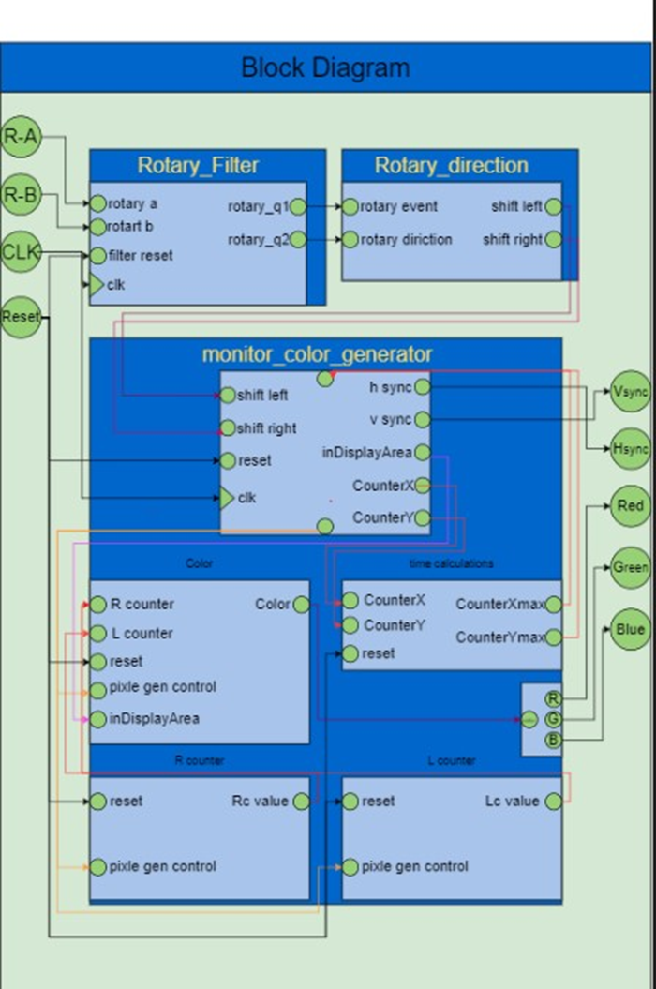
The Main Module
This block diagram shows how all the blocks that are connected.
And this represent the top-level module in the project.
Slide-10

Slide 11
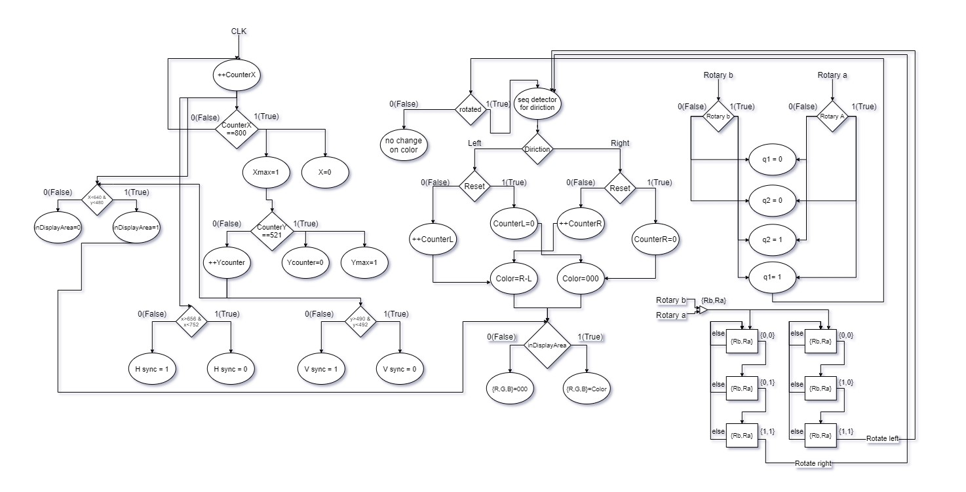
ASM Chart
Slide-11

Slide 12
Programming using FPGA is flexible, and the FPGA doesn’t take as much space as other processors do.
The VGA chip is easily controlled and has a variety of resolutions at different refreshing rate.
The rotary switch has the disadvantage of chattering, that has been easily solved through programming.
Modifying the VGA code by adding a shaft encoder was, simple job and fun to learn.
Conclusion
Slide-12

Slide 13
THANK YOU
Slide-13

